Slide 1
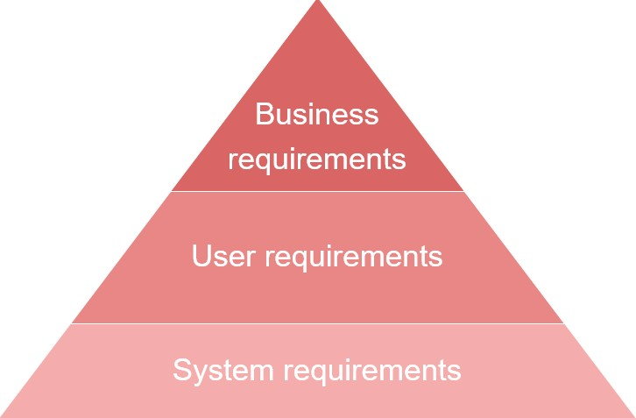
Understanding Requirements, Use Case and Use case Description

Slide 2
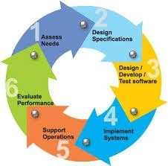
Requirements Engineering
Requirements Engineering
Requirements are statements of what the system must do, how it must behave, the properties it must exhibit, the qualities it must possess, and the constraints that the system and its development must satisfy.
Requirements analysis
specifies software’s operational characteristics
indicates software's interface with other system elements
establishes constraints that software must meet
2

Slide 3
Requirements Engineering
Inception—ask a set of questions that establish …
basic understanding of the problem
the people who want a solution
the nature of the solution that is desired, and
the effectiveness of preliminary communication and
collaboration between the customer and the developer
Elicitation—elicit requirements from all stakeholders
Elaboration—create an analysis model that identifies data, function and behavioral requirements
Negotiation—agree on a deliverable system that is realistic for developers and customers
3

Slide 4
Requirements Engineering
Specification—can be any one (or more) of the following:
A written document
A set of models
A formal mathematical
A collection of user scenarios (use-cases)
A prototype
Validation—a review mechanism that looks for
errors in content or interpretation
areas where clarification may be required
missing information
inconsistencies (a major problem when large products or
systems are engineered)
conflicting or unrealistic (unachievable) requirements.
Requirements management
4

Slide 5
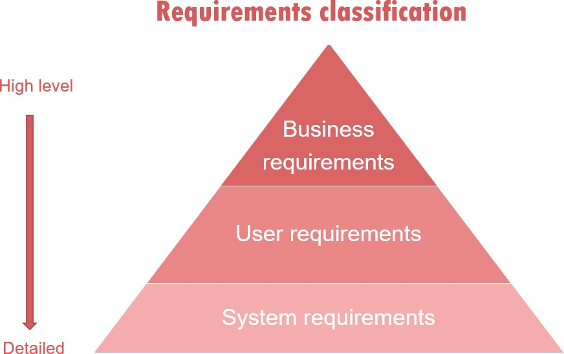
Classification of requirements
5

Slide 6
Classification of requirements
Business requirements. These include high-level statements of
goals, objectives, and needs.
Stakeholder requirements. The needs of discrete stakeholder groups are also specified to define what they expect from a particular solution.
Solution requirements. Solution requirements describe the characteristics that a product must have to meet the needs of the stakeholders and the business itself.
Nonfunctional requirements describe the general characteristics of a system. They are also known as quality attributes.
Functional requirements describe how a product must behave,
what its features and functions.
Transition requirements. An additional group of requirements defines what is needed from an organization to successfully move from its current state to its desired state with the new product.
6

Slide 7
Functional Requirements
Functional requirements describe system behavior under specific conditions and include the product features and functions
which web & app developers must add to the solution. Such requirements should be precise both for the development team and stakeholders.
The list of examples of functional requirements includes:
Business Rules
Transaction corrections, adjustments, and cancellations
Administrative functions
Authentication
Authorization levels
Audit Tracking
External Interfaces
Certification Requirements
Reporting Requirements
Historical Data
7

Slide 8
Example of Functional Requirements
Here, are some examples of non-functional requirement:
The software automatically validates customers against the
ABC Contact Management System
The Sales system should allow users to record customers sales
The background color for all windows in the application will be blue and have a hexadecimal RGB color value of 0x0000FF.
Only Managerial level employees have the right to view revenue data.
The software system should be integrated with banking API
The software system should pass Section 508 accessibility requirement.
8

Slide 9
Non-Functional Requirements
A non-functional requirement defines the quality attribute of a software system. They represent a set of standards used to judge the specific operation of a system. Example, how fast does the website load?
Some typical non-functional requirements are:
Performance – for example Response Time, Throughput,
Utilization, Static Volumetric
Capacity
Availability
Reliability
Recoverability
Maintainability
Serviceability
Security
Regulatory
Manageability
Environmental
Data Integrity
Usability
9

Slide 10
Example of Non-Functional Requirements
Here, are some examples of non-functional requirement:
Users must change the initially assigned login password immediately after the first successful login. Moreover, the initial should never be reused.
Employees never allowed to update their salary information. Such attempt should be reported to the security administrator.
Every unsuccessful attempt by a user to access an item of data shall be recorded on an audit trail.
A website should be capable enough to handle 20 million users with affecting its performance
The software should be portable. So moving from one OS to other
OS does not create any problem.
Privacy of information, the export of restricted technologies, intellectual property rights, etc. should be audited.
10

Slide 11
Elements of the analysis model
Elements of the analysis model
Scenario-based elements
Functional—processing narratives for software functions
Use-case—descriptions of the between an “actor” and the system
Class-based elements
Implied by scenarios
Behavioral elements
State diagram
Flow-oriented elements
Data flow diagram
interaction
11

Slide 12
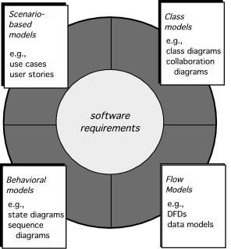
Elements of Requirements Analysis
12

Slide 13
Use-Cases
Use cases describe the interaction between the system and external users that leads to achieving particular goals.
Each use case includes three main elements:
Actors. These are the users outside the system that interact with the system.
System. The system is described by functional requirements that define an intended behavior of the product.
Goals. The purposes of the interaction between the users and the system are outlined as goals.
There are two formats to represent use cases:
Use case specification/description
Use case diagram
13

Slide 14
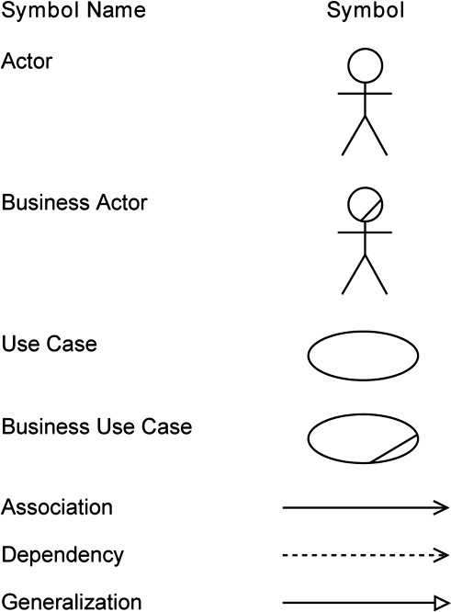
Use-Cases Elements

Slide 15
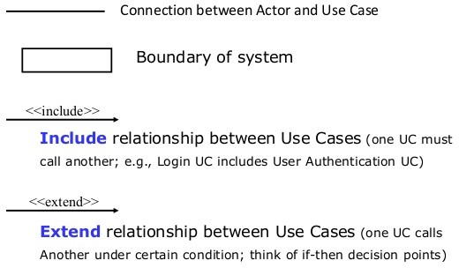
Use-Cases Elements

Slide 16
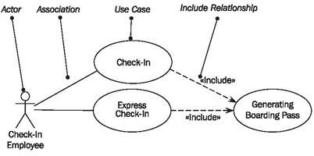
Use-Cases Elements

Slide 17
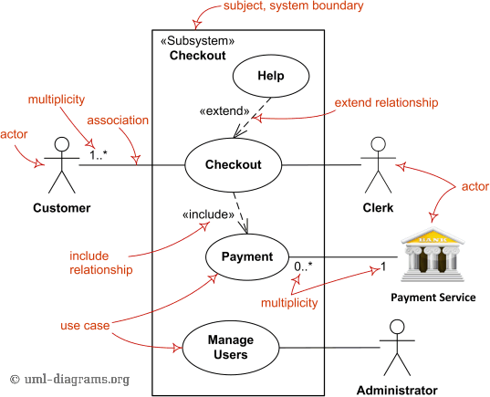
Use Cases diagramm

Slide 18
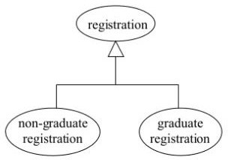
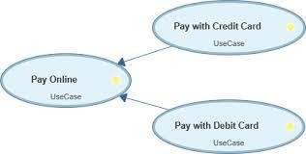

Use-Cases Generalization
The child use case inherits the behavior meaning of the parent use case
The Child may add to or override the behavior of its parent.

Slide 19

Use-Cases Diagram
Saf eHome
Access camera surveillance via t he Int ernet
cameras
Conf igure Saf eHome syst em paramet ers
homeowner
Set alarm

Slide 20












Use-Cases Diagram
Arms/ disarms syst em
Accesses syst em via Int ernet
sensors
homeow ner
Responds t o alarm event
Encount ers an error condit ion
Reconf igures sensors and relat ed
syst em f eat ures
20
syst em administ rat or

Slide 21
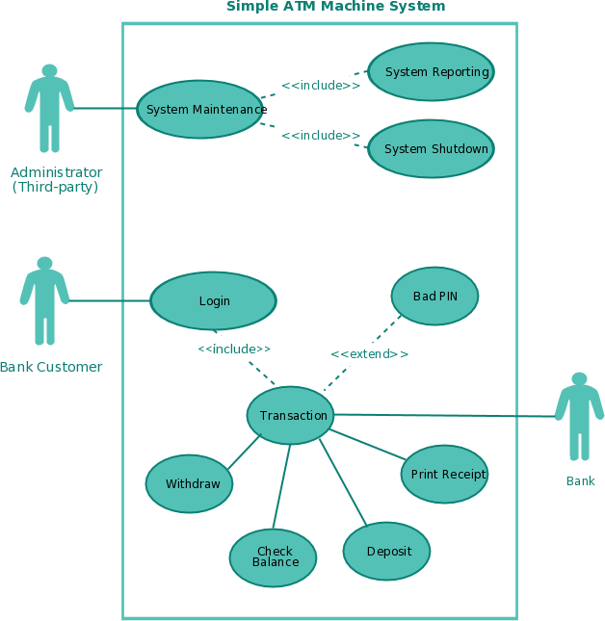
Use-Cases Diagram

Slide 22
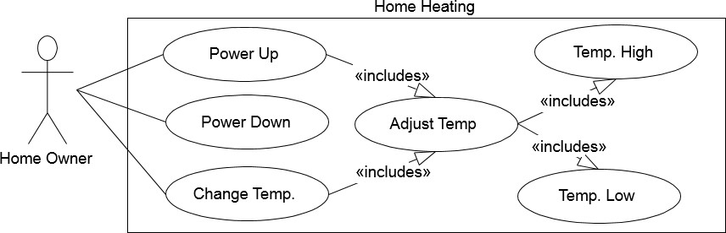
Home Heating System

Slide 23
Home Heating System
Use Case Description
Use case: Actors: Type: Description:
Power Up
Home Owner (initiator)
Primary and essential
The Home Owner turns the power on.
Perform Adjust Temp. If the temperature in all rooms is above the desired temperature, no actions are taken.
Cross Ref.:
Use-Cases:
Requirements XX, YY, and ZZ
Perform Adjust Temp

Slide 24
Home Heating System
Use case: Actors: Type: Description:
Adjust Temp System (initiator)
Secondary and essential
Check the temperature in each room. For each room:
Below target: Perform Temp Low
Above target: Perform Temp High
Cross Ref.: Use-Cases:
Requirements XX, YY, and ZZ Temp Low, Temp High

Slide 25
Home Heating System
Use case: Actors: Type: Description:
Temp Low System (initiator)
Secondary and essential
Open room valve, start pump if not started.
If water temp falls below threshold,
open fuel value and ignite burner.
Requirements XX, YY, and ZZ None
Cross Ref.: Use-Cases:

Slide 26
Use Case Scenario
Home Assignment distribution and Collection System(HACS)
Homework assignment and collection are an integral part of any educational system. Today, this task is performed manually. What we want the homework assignment distribution and collection system to do is to automate this process.
The system will be used by the Instructor/Teacher to distribute the homework assignments, review the students’ solutions, distribute
suggested solution, and distribute student grades on each assignment.
This system will also help the students by automatically distributing the assignments to the students, provide a facility where the students can submit their solutions, remind the students when an assignment is almost due, remind the students when an assignment is overdue.
26

Slide 27
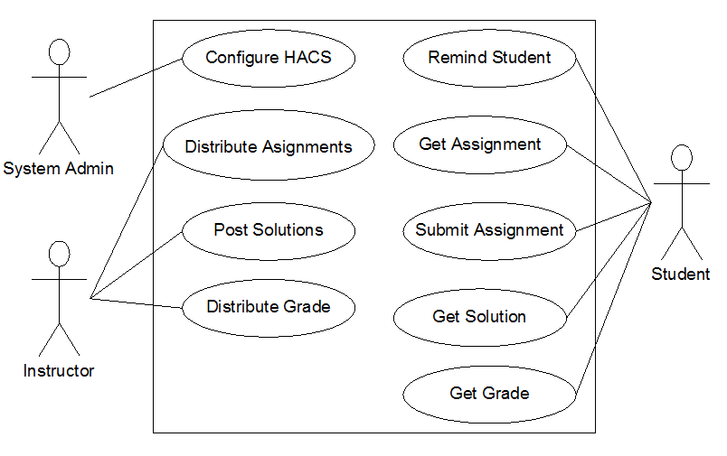
Home Assignment distribution and Collection System Use Case Diagram

Slide 28
HACS Use Cases Description
Use case: Actors: Type: Description:
Distribute Assignments Instructor (initiator) Primary and essential
The Instructor completes an assignment and
submits it to the system. The instructor will also submit the due date and the class the assignment is assigned for.
Cross Ref.:
Use-Cases:
Requirements XX, YY, and ZZ
Configure HACS must be done before any user (Instructor or Student) can use HACS

Slide 29
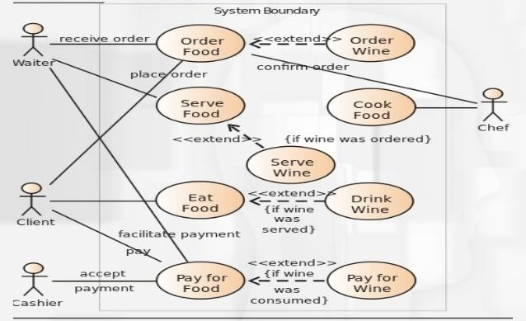
Use Cases Diagram for Restaurant

Slide 30
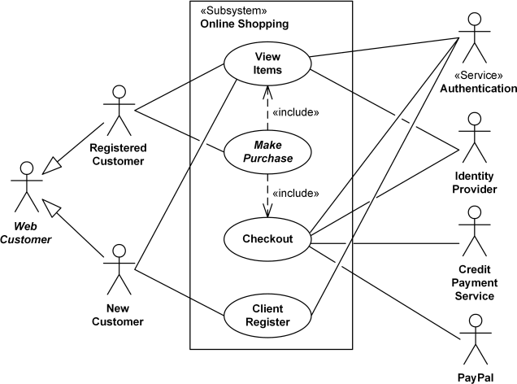
Use Case Diagram Online Shopping

Slide 31
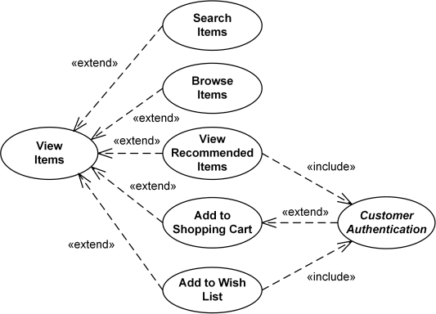
Use Case Diagram- View Items

Slide 32
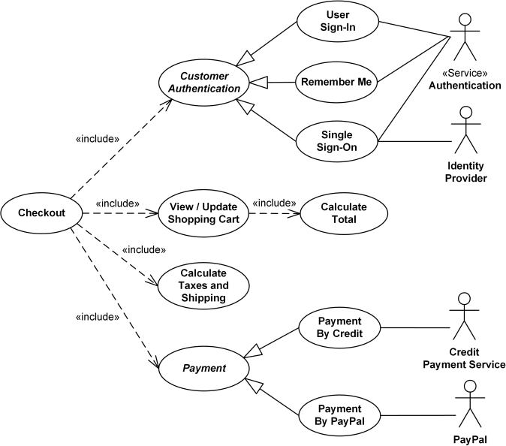
Use Case Diagram - Checkout

Slide 33
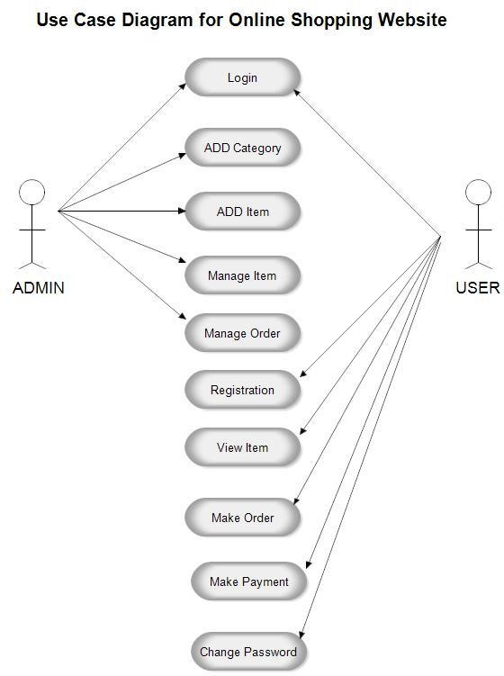

Slide 34
Example-1: Use Case Scenario
A user can request a quiz for the system. The system picks a set of questions from its database, and compose them together to make a quiz. It rates the user’s answers, and gives hints if the user requests it.
In addition to users, we also have tutors who provide questions and hints. And also examinations who must certify questions to make sure they are not too trivial, and that they are sensual.
Make a use case diagram to model this system. Work out some of your use cases. Since we don’t have real stake holders here, you are free to fill in details you think is sensual for this example.
34

Slide 35
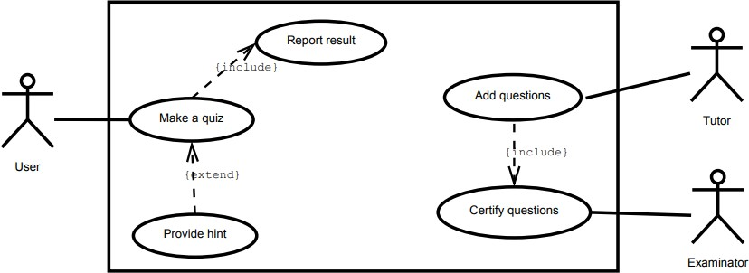
Use Case Diagram

Slide 36
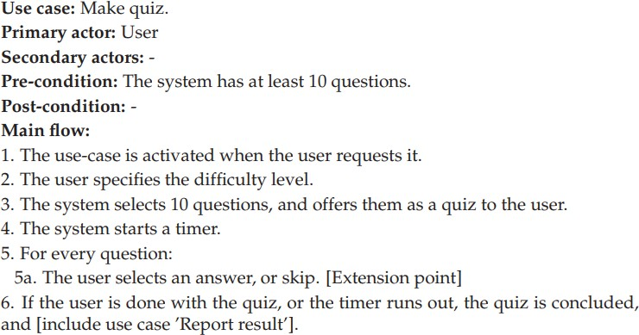
Use Case Description

Slide 37
Example-2: Use Case Scenario
Suppose we want to develop software for an alarm clock.
The clock shows the time of day. Using buttons, the user can set the hours and minutes fields individually, and choose between 12 and 24-hour display.
It is possible to set one or two alarms. When an alarm fires, it will sound some noise. The user can turn it off, or choose to ’snooze’. If the user does not respond at all, the alarm will turn off itself after 2 minutes. ’Snoozing’ means to turn off the sound, but the alarm will fire again after some minutes of delay. This ’snoozing time’ is pre-adjustable.

Slide 38
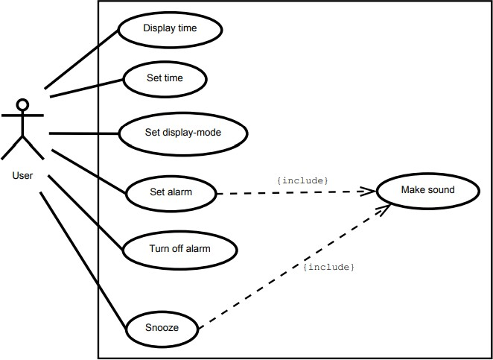
Use Case Diagram

Slide 39
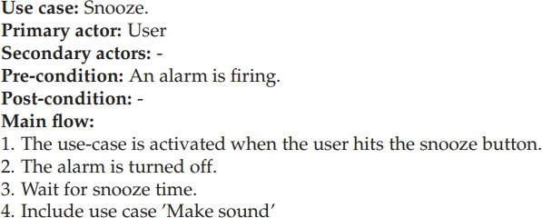
Use Case Description

Slide 40
Use Case Description

Slide 41
References:
Software Engineering A practitioner’s Approach by Roger S. Pressman, 7th edition, McGraw Hill, 2010.
Software Engineering by Ian Sommerville, 9th edition,
Addison-Wesley, 2011
FUNCTIONAL VS NON-FUNCTIONAL REQUIREMENTS: MAIN DIFFERENCES & EXAMPLES https://theappsolutions.com/blog/development/functional-vs-non- functional-requirements/

